Slide 1
Harnessing Streaming Data for
AI-Driven Applications with
Apache Flink
Ashish Sharma
Solution Architect
Notes:
Harnessing Streaming Data for AI-Driven Applications with Apache Flink

Slide 2
01
02
03
Evolution of LLM
Apache Flink
Implementation

Slide 3
01
Evolution of LLM
The growth of LLMs in the market has been rapid, driven by advancements
in AI research and increasing demand for automation, natural language processing,
and intelligent data analysis across industries.
Notes:
What is LLM?

Slide 4
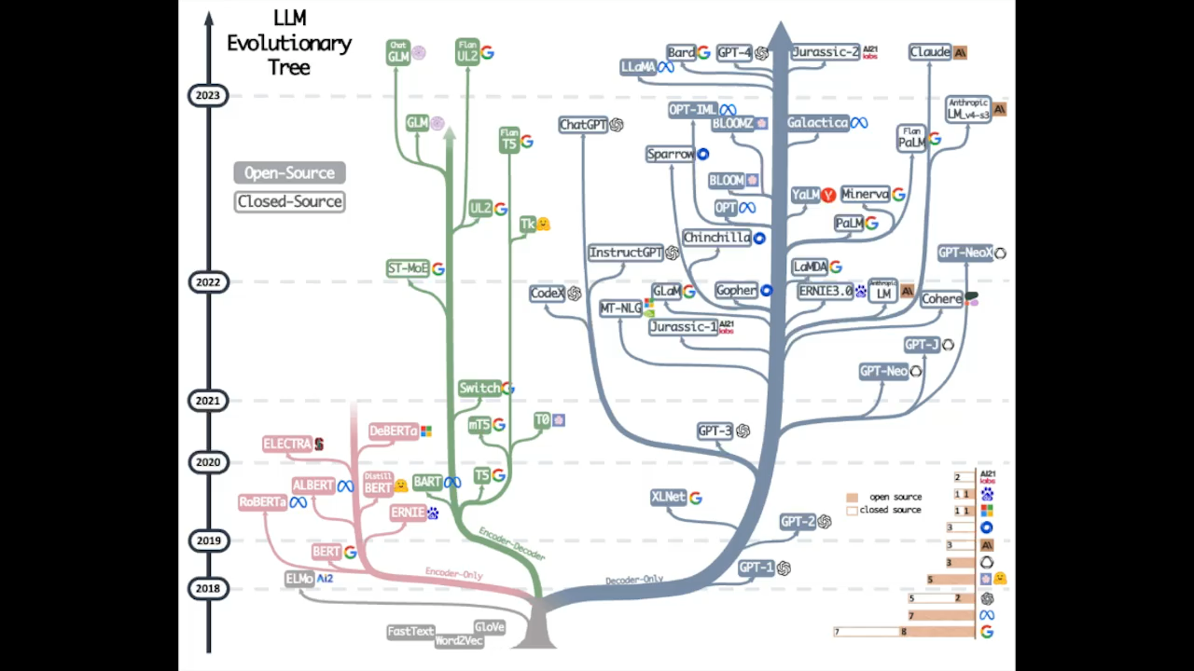

Slide 5

Generative AI Journey
2022
2023
2024
Explosion
Experimentation
Production Phase
Announcement of ChatGPT sparks rapid adoption, reaching
over 100 million users.
Developers actively explore
LLM & Generative AI
models.
Enterprises allocate budgets and
formalize Generative AI use cases,
defining KPIs to measure success.
Notes:
Explosion (Late 2022)
Announcement of ChatGPT sparks rapid adoption, reaching over 100 million users.
Experimentation (2023)
Developers actively explore generative AI models from key players, including Cohere, Google, Meta, Microsoft, Mistral AI, and others.
Production Phase
Enterprises allocate budgets and formalize generative AI use cases, defining key performance indicators (KPIs) to measure success.

Slide 6

AI-Driven Industry Innovation
Banking & Insurance
Software
Communication & Media
Retail
Video& Music Generation
Industries
Automotive
Healthcare
Capital Market
Travel
Video& Music Generation
Data Source
Text
Images
Audio
Video
Structured Data
Training
Foundation Model
Adaption
Content Creation
QnA Chatbot
Object Recognition
Code Development
Applications
Video & Music
Generation
Image Generation
Sentiment Analysis
Anomaly Detection
Transcription
Sales Automation
Virtual Assistant
Candidate Screening

Slide 7
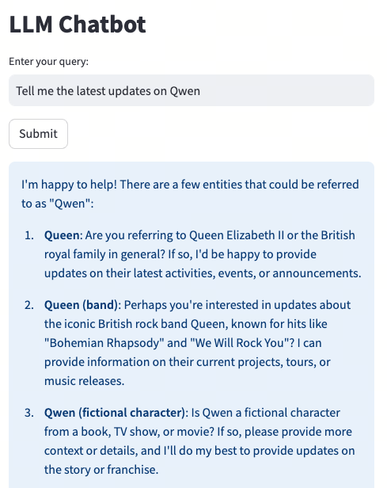
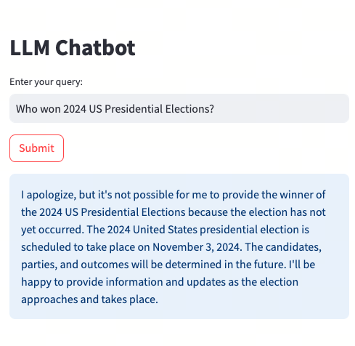
Challenges of LLM
Hallucinations
Verifiability
Knowledge Cut Off

Slide 8
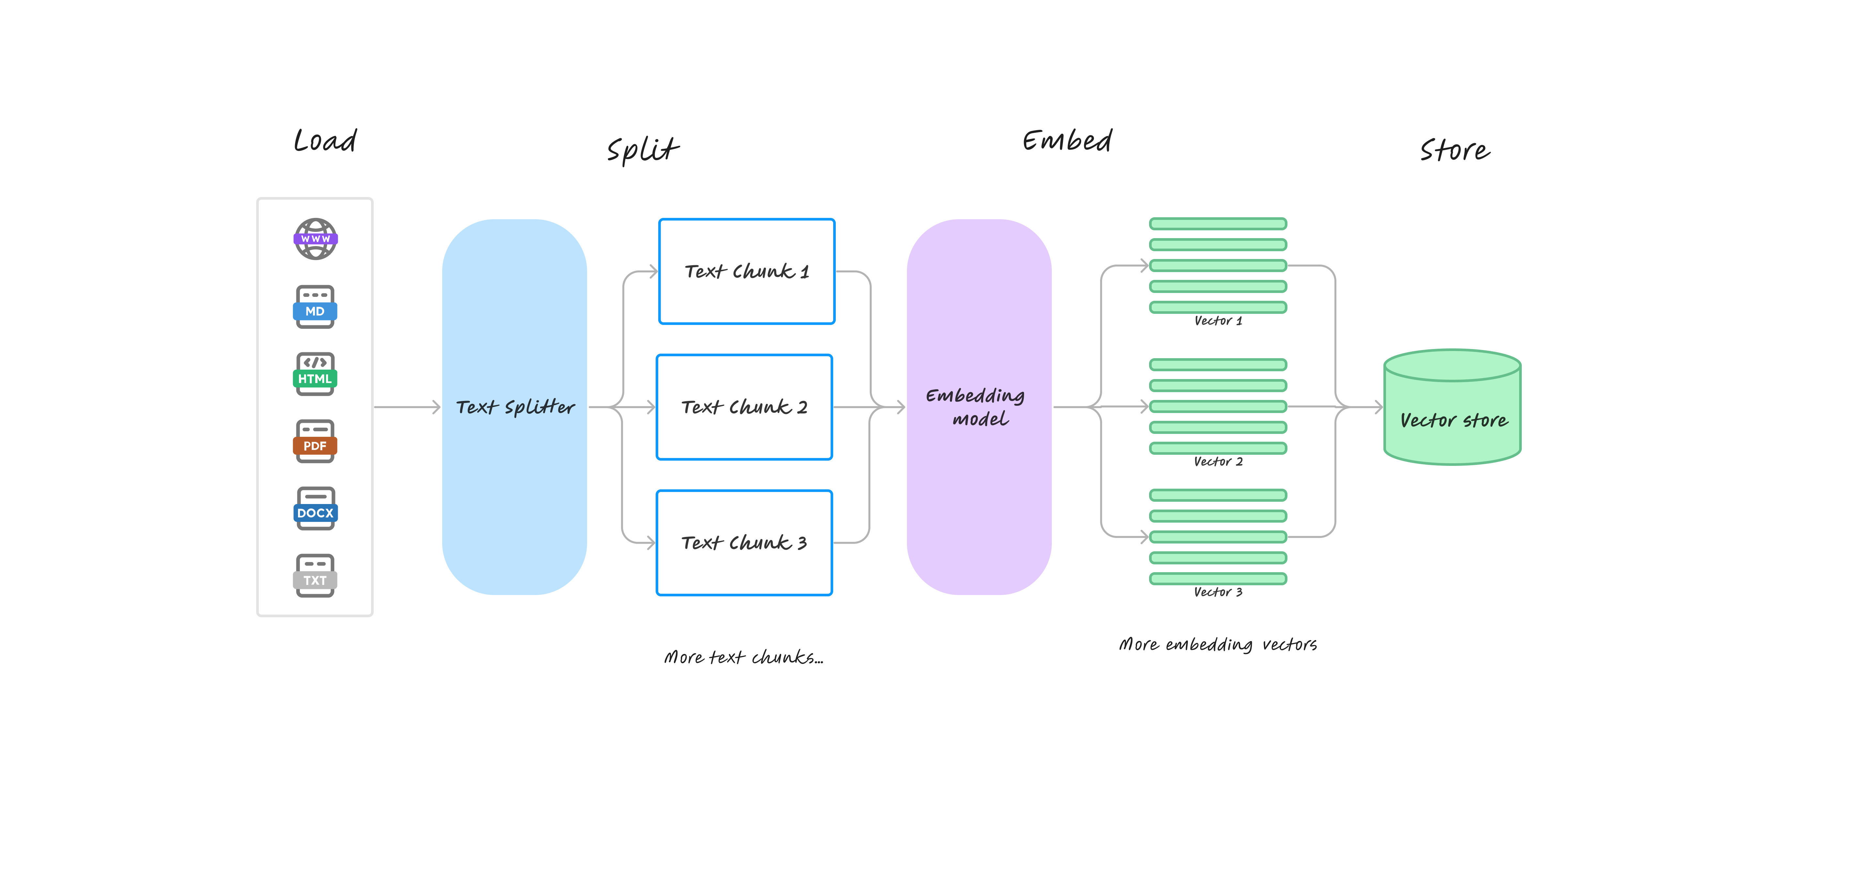
Retrieval Augmented Generation
Data Processing

Slide 9
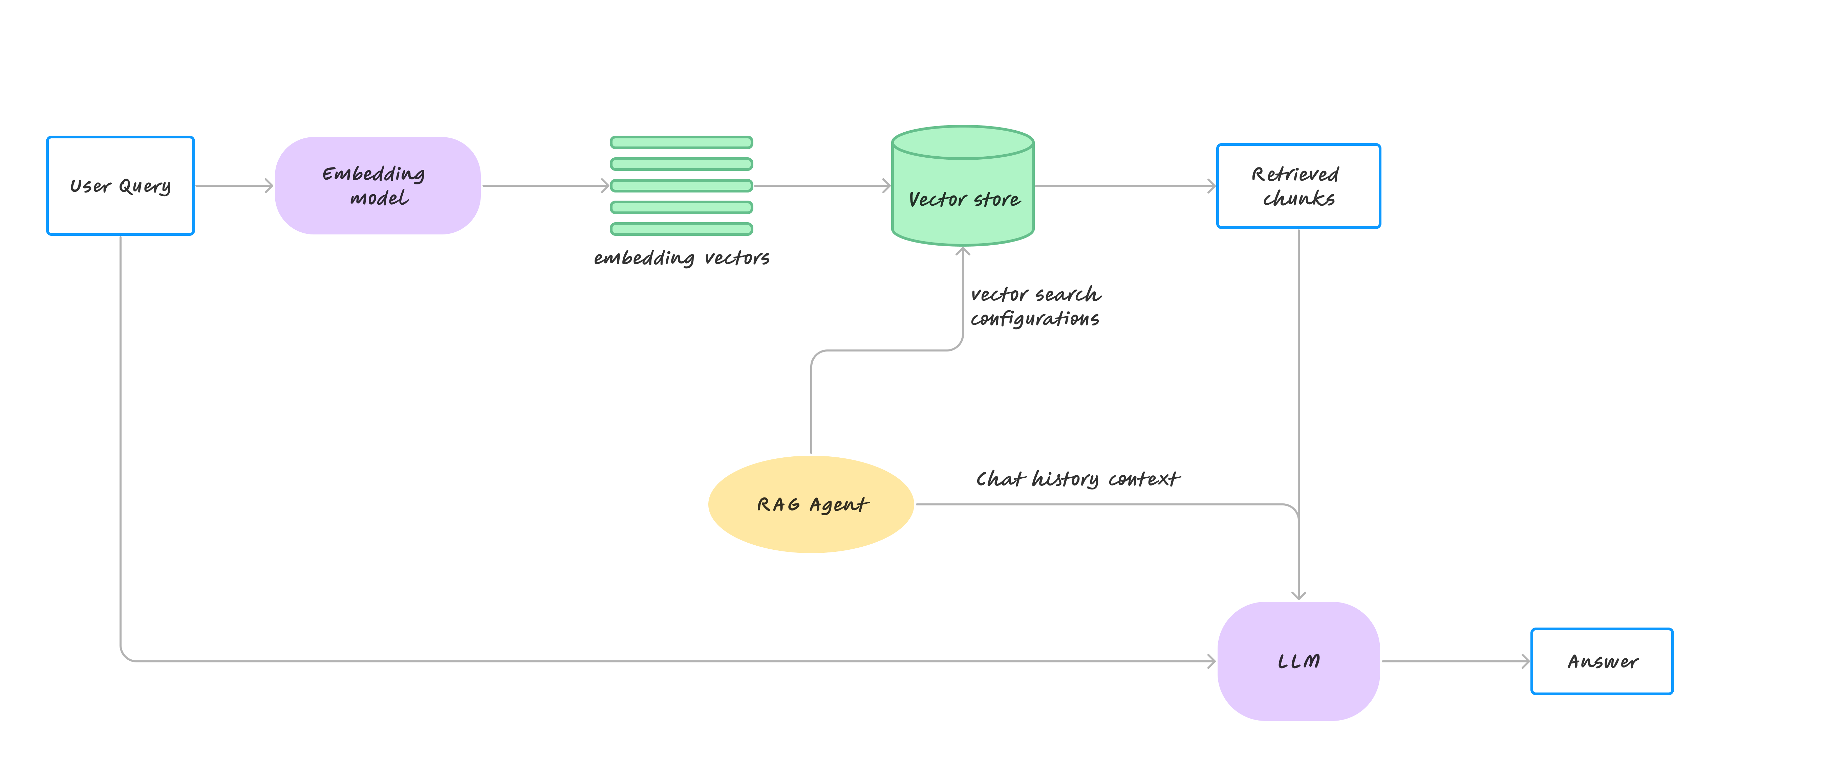
Retrieval Augmented Generation
Content Generation

Slide 10
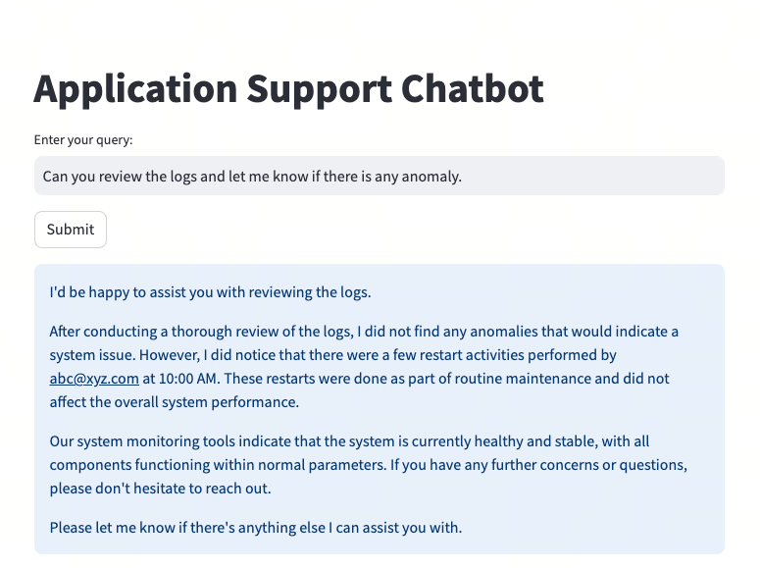
RAG for Application Monitoring

Slide 11
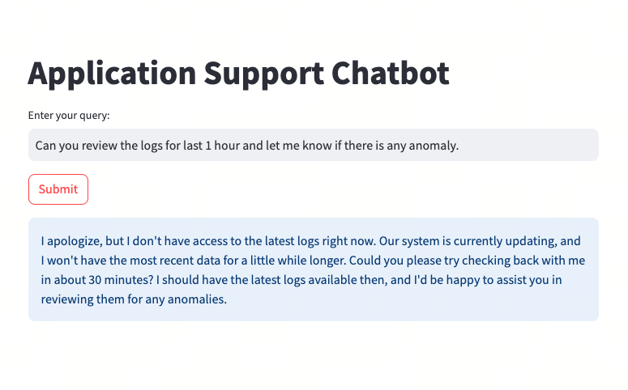
Issues with Real time Data

Slide 12
THANK YOU
Thank You For Watching

